Slide 1
Blockchain & Business Application
Lecture:
Consensus Protocols

Slide 2

Chapter 2: How Bitcoin Achieves Decentralization

Slide 3
Centralization vs. Decentralization
the Internet, a famously decentralized sys.
E-mail/Msgs: decentralized or centralized?
Simple Mail Transfer Protocol (SMTP)
Facebook, LinkedIn?
Decentralization is not all or nothing!
Bitcoin: Decentralized
Exchange, wallet softwares?

Slide 4
How the Bitcoin protocol achieves decentralization
Who maintains the ledger of transactions?
Who has authority over which transactions are valid?
Who creates new bitcoins?
Who determines how the rules of the system change?
How do bitcoins acquire exchange value?
Questions 1-3: technical; focus of this chapter

Slide 5
Different aspects of Bitcoin fall on different points on the centralization/decentralization spectrum.
The peer‐to‐peer network is close to purely decentralized: Anybody can run a Bitcoin node: fairly low barrier to entry.
Bitcoin mining: also technically open to anyone, but it requires a very high capital cost.
High degree of centralization / concentration of power
Updates to the software that Bitcoin nodes run

Slide 6
Decentralization → Distributed Consensus
Distributed consensus protocol:
There are n nodes that each have an input value. Some of these nodes are faulty or malicious.
A distributed consensus protocol has the following two properties:
It must terminate with all honest nodes in agreement on the value
The value must have been generated by an honest node

Slide 7
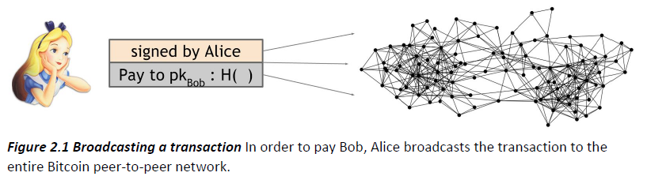
Where is Bob?
a variety of users are broadcasting these transactions to the network:
the nodes must agree on exactly which transactions were broadcast &
the order in which these transactions happened
single, global ledger for the system

Slide 8
At any given point, all the nodes in the peer‐to‐peer network have a ledger
consisting of a sequence of blocks,
each containing a list of transactions,
that they’ve reached consensus on.

Slide 9
Additionally, each node has a pool of outstanding transactions
that it has heard about but have not yet been included on the block chain
consensus has not yet happened
Each node might have a slightly different version of the outstanding transaction pool

Slide 10
How do nodes come to consensus on a block
One way:
at regular intervals, say every 10 minutes,
every node in the system proposes its own outstanding transaction pool to be the next block.
nodes execute some consensus protocol,
each node’s input is its own proposed block
some nodes may be malicious
put invalid transactions into their blocks
assume others are honest

Slide 11
If the consensus protocol succeeds, a valid block will be selected as the output.
Even if the selected block was proposed by only one node, it’s a valid output if the block is valid.
some valid outstanding transaction may not get included in the block,
it could just wait and get into the next block
This is similar to Bitcoin, but not exactly same

Slide 12
Problems of this approach
Consensus: A hard problem nodes might
crash / be malicious
Network is highly imperfect
Not a complete graph but peer-to-peer
Poor internet connection
Huge latency
Distributed to all over the Internet

Slide 13
Bitcoin protocol must reach consensus in the face of two types of obstacles:
Imperfections in the network
latency (global time?)
nodes crashing
Deliberate attempts by some nodes

Slide 14
Impossibility results
The lack of global time heavily constrains
Byzantine Generals Problem:
Army divisions, commanded by generals
Generals communicate by messenger on joint plan
Some generals may be traitors, prevent joint plan
Loyals try for consensus
Proven: 1/3 traitor treshold!
Bad news!

Slide 15

Byzantium Empire

Slide 16
Good news?
Impossibility proofs are for specific models
Bitcoin is beyond traditional assumptions
It runs better in practice than in theory!
Incentives: currency → natural to act honestly
Consensus for currency, not general
Randomness
Consensus in long time (practically 1 hour)

Slide 17
Consensus without identity
Sybil attack:
Sybils are just copies of nodes that a malicious adversary can create
to look like there are a lot of different participants,
in fact all those controlled by the same adversary
No identity
Lottery, ticket etc.
Random node selection
All Sybils may be treated as one node!

Slide 18
Bitcoin consensus algorithm (simplified)
Simplified: assumes selecting a random node is not vulnerable to Sybil attacks
New transactions are broadcast to all nodes
Each node collects new transactions into a block
In each round a random node gets to broadcast its block
Other nodes accept the block only if all transactions in it are valid (unspent, valid signatures)
Nodes express their acceptance of the block by including its hash in the next block they create
Why does this work?

Slide 19
Consider malicious adversary: Alice
Stealing Bitcoins:
Can Alice simply steal bitcoins belonging to another user at an address she doesn’t control?
No. Even if it is Alice’s turn to propose the next block, she cannot steal!
It would require Alice to create a valid transaction that spends that coin.
It would require Alice to forge the owners’ signatures -→ secure digital signature scheme.
IF underlying cryptography is solid, she cannot steal

Slide 20
Consider malicious adversary: Alice
Denial of service attack.
Say Alice really dislikes some other user Bob.
Alice can decide to include no transactions originating from Bob’s address in any block that she proposes
While this is a valid attack that Alice can try to mount, luckily it’s nothing more than a minor annoyance.
If Bob’s transaction doesn’t make it into the next block by Alice, he will just wait until an honest node
So that’s not really a good attack either.

Slide 21
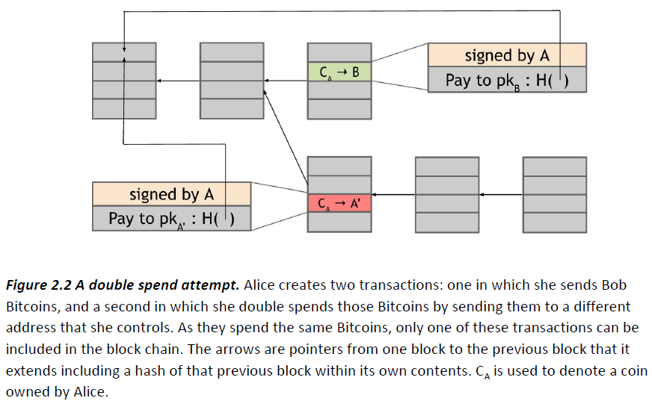
Alice: Double Spend Attempt

